Slide 1

Balanced scorecard slide 1
Big Data Technologies Final Project
Group 11: Sebastian Valencia ID: 986775
Carlos Hernandez ID: 986636
Prof.: Mrudula Mukadam
Dec -2018
“Life doesn’t happen in batches”, Ted Dunning
c

Slide 2
Balanced scorecard slide 8
OUTLINE
Project description
Technologies used
Demo
Research: Kafka + Power BI
c

Slide 3







Balanced scorecard slide 8
Project Description
Using Tweeter as our source to develop a streaming solution to capture tweets related to Social Networks (#facebook, #tweeter, #youtube, #linkedin), to do the sentimental analysis, clasify each tweet as Positive, Negative or Neutral; to storage that tweets to an Hbase database and to present them in a nice format using a visualizer tool.
Sentimental Analysis
c
Notes:
https://www.youtube.com/watch?v=udnX21__SuU

Slide 4
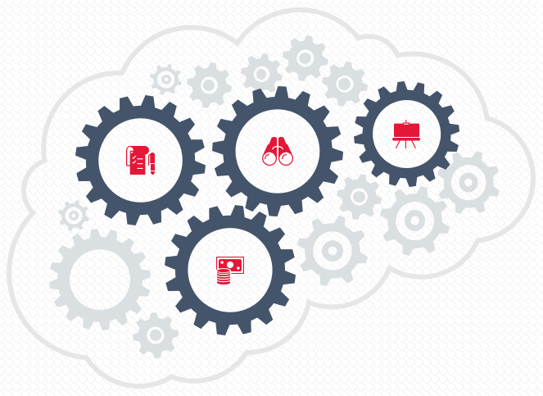
Balanced scorecard slide 8
Technologies used
Spark Streaming
Python 3.5.1, PySpark
Apache Kafka
Cloudera/Centos, HBase, Hive
TextBlob Library for Sentimental Analysis
MS Power BI for visualization
Simba ODBC Driver for Hive
v

Slide 5
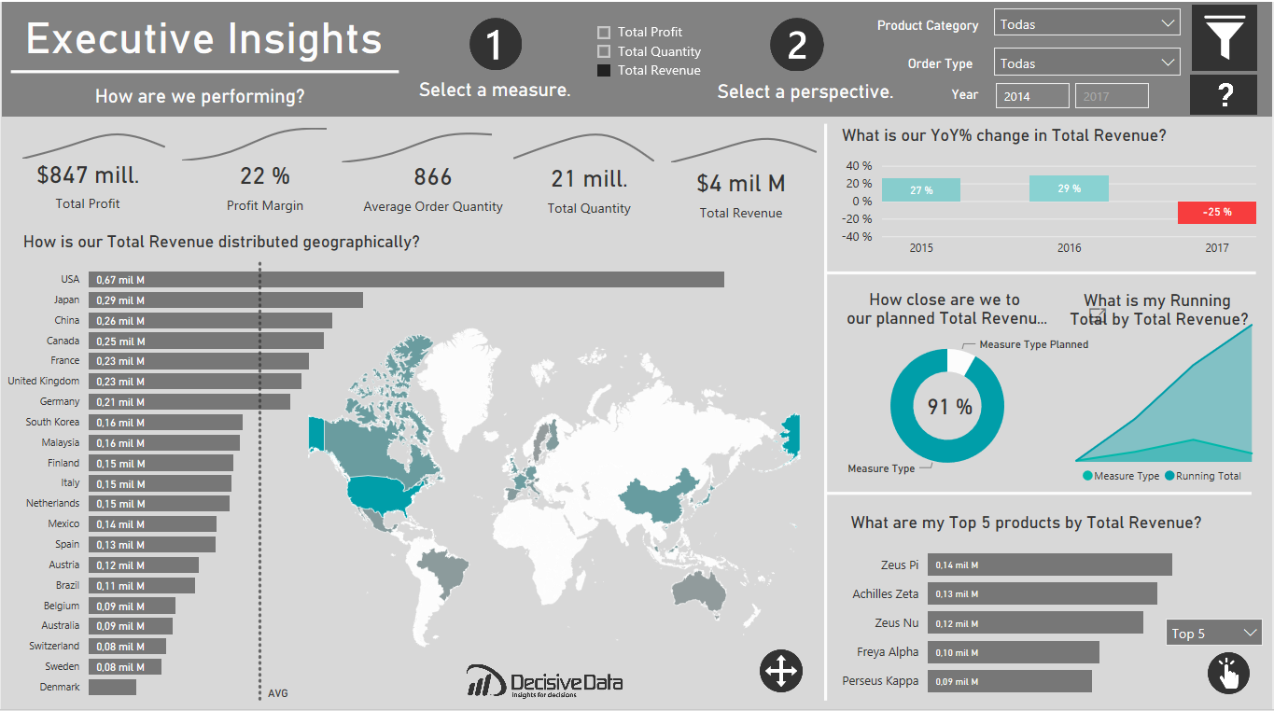
Balanced scorecard slide 8
MS Power BI
A business analytics Visualizer provided by Microsoft. It provides interactive visualizations with self-service business intelligence capabilities, where end users can create reports and dashboards by themselves, without having to depend on IT staff.
c
Notes:
Multiple sources, Natural languages, Cloud

Slide 6
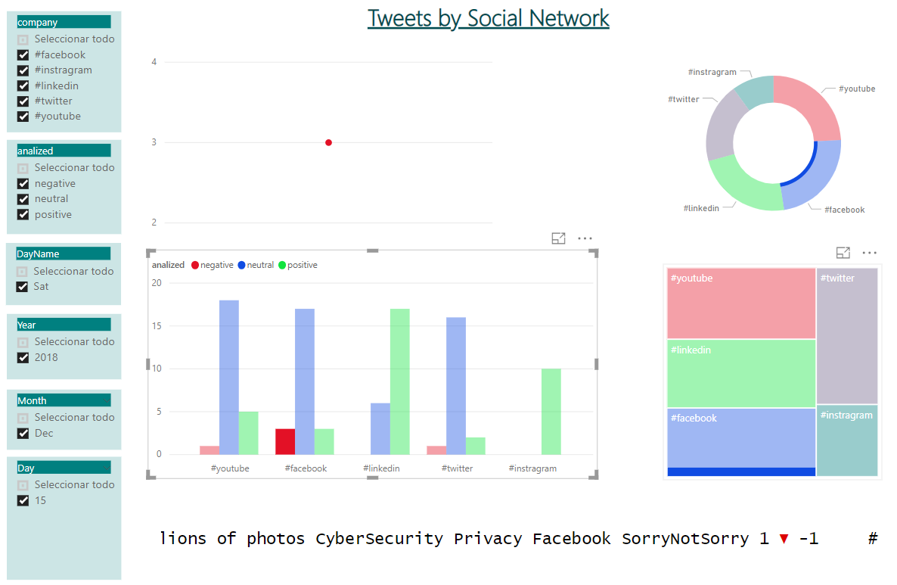
Balanced scorecard slide 3
Demo: Dashboard + Streaming
c

Slide 7
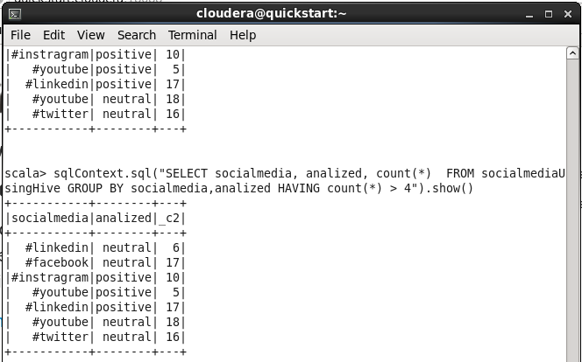
Balanced scorecard slide 8
Spark SQL
Using Spark SQL in our data captured from tweeter, recorded into HBase and exported to text file:
v
Notes:
Producer: An application that sends messages to Kafka.
Consumer: An application that reads data from Kafka.
Broker:An agent to exchange messages between Producer and Consumer (do not interact directly)
Cluster: Group of computers sharing workload for a common purpose. Each one executing one instance of kafka broker.
Topic: A unique name for Kafka stream.
Partitions: The data could be huge, so it is partitioned and distributed in computers in the cluster.
Offset: A sequence id given to messages as they arrive in a partition.
Consumer Groups: A group of consumers acting as a single logical unit.
https://www.youtube.com/watch?v=udnX21__SuU

Slide 8
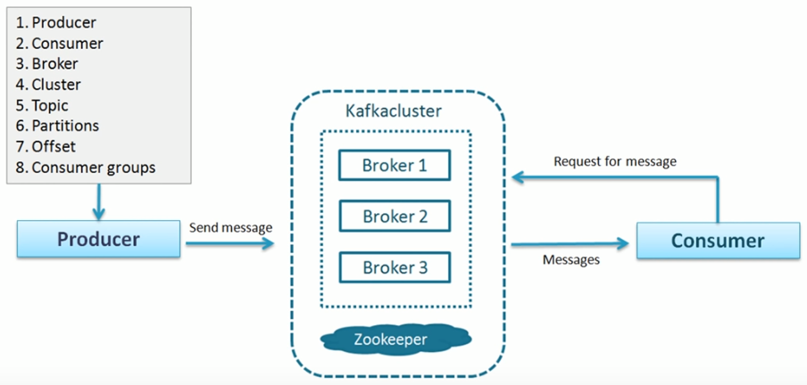
Balanced scorecard slide 8
Apache Kafka
Open-source stream-processing software platform developed by the Apache Software Foundation, written in Scala and Java. The project aims to provide a unified, high-throughput, low-latency platform for handling real-time data feeds
v
Notes:
Producer: An application that sends messages to Kafka.
Consumer: An application that reads data from Kafka.
Broker:An agent to exchange messages between Producer and Consumer (do not interact directly)
Cluster: Group of computers sharing workload for a common purpose. Each one executing one instance of kafka broker.
Topic: A unique name for Kafka stream.
Partitions: The data could be huge, so it is partitioned and distributed in computers in the cluster.
Offset: A sequence id given to messages as they arrive in a partition.
Consumer Groups: A group of consumers acting as a single logical unit.
https://www.youtube.com/watch?v=udnX21__SuU

Slide 9
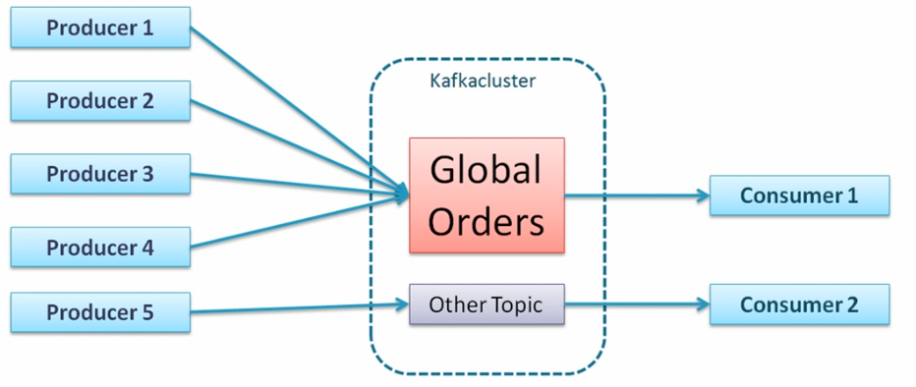
Balanced scorecard slide 8
Apache Kafka
Producer: An application that sends messages to Kafka.
Consumer: An application that reads data from Kafka.
Broker:An agent to exchange messages between Producer and Consumer (do not interact directly)
Cluster: Group of computers sharing workload for a common purpose. Each one executing one instance of kafka broker.
Topic: A unique name for Kafka stream.
Partitions: The data could be huge, so it is partitioned and distributed in computers in the cluster.
Offset: A sequence id given to messages as they arrive in a partition.
Consumer Groups: A group of consumers acting as a single logical unit.
Topic Ex:
c
Notes:
Kafka doesn’t take the decisión of how many partition for a token. A partition is a single machine. You have to calculate.
Global unique identifier of a message: Topic Name + Partition number + Offseet

Slide 10
Balanced scorecard slide 10
THANK YOU

